Slide 1
Lessons Learned from Amherst
October 17, 2019

Slide 2
Overview
Background & Context in Amherst
Local Legislative Actions
Host Community Agreement Recommendation Process
Status of Amherst Marijuana Establishments
Lessons Learned

Slide 3
Background & Context
in Amherst

Slide 4
Amherst’s Cannabis History
Cannabis Reform Coalition Records (RG 045/80/C3). Special Collections and University Archives, UMass Amherst Libraries.

Slide 5
Ballot Question Results
5th highest approval in the state

Slide 6
Community Profile
Total Population: 39,880
Median Age: 21.4
Population under 21: 17,830 (45%)
5,000+ new residents annually < 21 years old (first year college students)

Slide 7
Competing Priorities
Clear mandate from residents for legal cannabis
Protection of large, continuously changing population of residents under 21 years old

Slide 8
Starting Premise
A commitment to implementing the recreational marijuana law in a safe and responsible manner.

Slide 9
Informal Working Group
Cannabis Policy
Town Manager
Planning
Health
Elected Officials
Economic Development
Police

Slide 10
Local Legislative Actions

Slide 11
Local Legislative Actions
2013:
Adoption of zoning for medical marijuana
2017:
Adoption of 3% local option tax on adult-use
Adoption of bylaw prohibiting public consumption
Adoption of zoning for adult-use retail
Adoption of limitation on adult-use retail to eight establishments
2018:
Adoption of zoning for other adult-use categories

Slide 12
Legislative Actions in Context
DATE | MILESTONE
9/18/2017 | Select Board marijuana discussion
9/19/2017 | Zoning Articles Hearing
11/6/2017 | Fall Special Town Meeting
3/15/2018 | CCC Regulations Due
3/27/2018 | Amherst Town Elections
4/1/2018 | CCC Begins Accepting Applications
4/23/2018 | Annual Town Meeting
6/1/2018 | Marijuana licenses issued
11/6/2018 | State Election
11/12/2018 | 2018 Fall Special Town Meeting
12/12/2018 | CCC Regulates Medical Marijuana

Slide 13
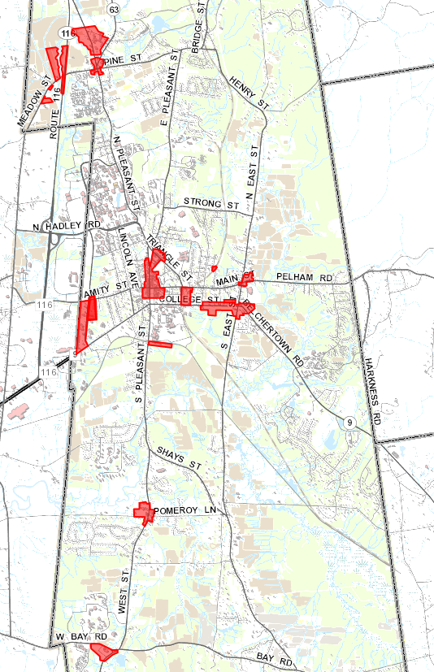
Zoning for Retail

Slide 14
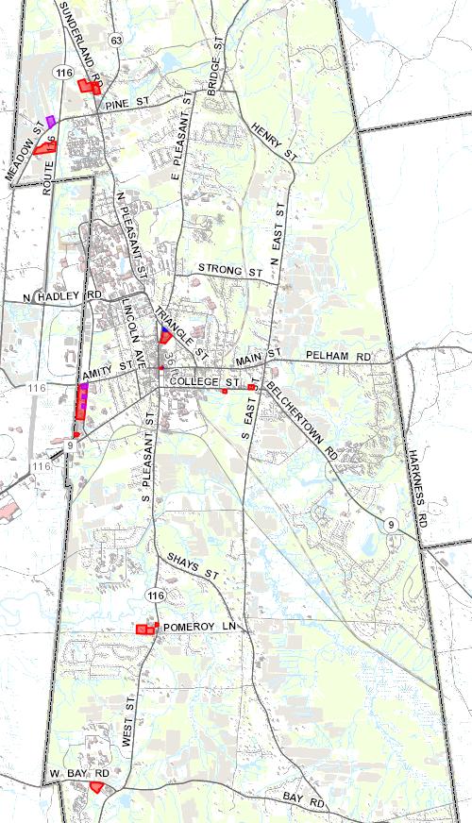
Zoning for Retail
Legend:
Potential Recreational Parcel
Potential Mixed-use Building
Likely Medical Establishment
North Amherst 5 parcels
Downtown
12 parcels
1 mixed-use building
University Drive
10 parcels
College Street
2 parcels
Pomeroy Village
3 parcels
Atkins Corner
1 parcel
Notes:
At least half of the “downtown” parcels eliminated when CCC adopted regulations creating a 500’ buffer around k-12.
We also have a buffer of 300’ between establishments, so places like University Drive can really only support 3 or 4 establishments

Slide 15
Zoning for Retail
Zoning districts are appropriate, but standards and conditions require 300 foot buffer from any building:
Containing another marijuana establishment;
Where children commonly congregate;
That are part of a higher education campus;
That are a public library; or
That contain a residential use (except mixed-use)
Notes:
Where children commonly congregate is a point in time determination that can only be advised of at the time of the Special Permit application
In Amherst, nearly all zones where retail are allowed is surrounded by residential zones, which severely restricts eligible locations

Slide 16
Host Community Agreement Recommendation Process

Slide 17
HCAs – Town Review Team
Economic Development Director
Select Board Member
Planning Director
Police Chief
Health Director

Slide 18
Town Review Team Process
Submittal
Potential operator submits requested material
Town Review Team Meeting
Potential operator meets with the Town Review Team to discuss submittal
Host Community Agreement Decision
Town Manager decides whether to enter into an HCA with the potential operator
Community Outreach Meeting
Potential operator hosts a community outreach meeting
Cannabis Control Commission Application
A potential operator with signed HCA can submit application to the CCC
Local Permitting Process
Once the potential operator has submitted an application to the CCC, it may apply for local permitting

Slide 19
Information Requested
Location and property interest
Business summary
Experience operating a marijuana establishment
Equity considerations
Signed acknowledgement of receipt of guidance document and that the establishment may be subject to local licensure requirements in the future
Notes:
Location and Property Interest: The physical address of the proposed location as well as proof of the marijuana establishment’s interest in the property. Documents that will satisfy the proof of property interest requirement include, but are not limited to, a purchase and sale agreement or lease. If the marijuana establishment’s property interest does not encompass the entire property or building, include a description of the part of the building to be used for the marijuana operation, a rough sketch of the building/property that clearly indicates the portion to be used for the marijuana establishment, as well as other uses or businesses operating in the building or on the property. Attach proof of the marijuana establishment’s interest in the property.
Business Summary: A summary of the proposed business, not to exceed 3 pages. The summary should include the contact information for the primary point of contact to discuss the submittal, a description of the management and operations of the business, the total number of expected full-time equivalent employees, the types of products to be sold by the establishment, revenue and growth estimates for the first 5 years of operation, a proposed timeline to be operational, as well as a brief description of any renovation, redevelopment, or new construction anticipated, hiring of local residents, and commitment to use of local businesses for construction, supplies, and other business needs. The summary should also include descriptions of the business’ diversity, sustainability, and consumer education plans. The diversity summary should describe the business’ plan to promote minority and gender equity, including consideration of veterans and people with disabilities. The sustainability description should include how the business will address issues such as energy and water conservation. The consumer education information should describe how the business plans to educate consumers about the law and responsible use of marijuana. The business summary should also include any unique or differentiating aspects of the business as compared to other recreational marijuana retail businesses.
Experience Summary: A summary, not to exceed 1 page, of any experience operating a marijuana establishment. The summary should include the type (medical, recreational, retail, cultivation, etc.), location (municipality and state), and length of time operating the marijuana establishment.
Equity Considerations: Information related to the marijuana establishment’s social equity experience and business practices, such as Commonwealth certification as an economic empowerment applicant; participation in the CCC social equity program; principals’ and employees’ years of residence in an area of disproportionate impact, including Amherst, which the CCC designated as an area of disproportionate impact; past convictions of business principals, employees, or families, for a marijuana-related offense; and other considerations such as commitments to hiring women, minorities, veterans, and people with disabilities.
Acknowledgement: Please see Acknowledgement in section 5, below.

Slide 20
Holistic Evaluation
Holistic Evaluation
Location
Educational Material
Economic Value
Experience
Uniqueness
Notes:
Location – Whether a recreational marijuana establishment is the highest and best use of the property, whether it will improve vacant or underutilized property, the proximity to other marijuana establishments, traffic impacts, and consistency with the Amherst Master Plan.
Educational Material – The quality of the business’ plan to educate the public and consumers about legal and responsible marijuana use.
Consistency with Community Values – Whether the proposed business’ plans with respect to diversity, equity, and sustainability adequately reflect community expectations.
Economic Value – The amount of additional economic value the business would bring to Amherst, such as new jobs, additional local tax revenue, hiring of local residents, and commitment to use of local businesses for construction, supplies, and other business needs.
Experience – Any experience operating a marijuana establishment, specifically a recreational marijuana retail establishment and experience in Massachusetts
Uniqueness of Proposal – Particular commitments, policies, programs, products, etc. that would distinguish the recreational marijuana retail establishments from other similar establishments.

Slide 21
Status of Amherst Marijuana Establishments

Slide 22
Medical Establishments
Organization | Proposed Location | Date Letter Requesting Support Received | Date Select Board Acted to Support | Host Community Agreement | Special Permit Status | Date of Opening
MassMedicum Corporation | 85 University Drive | January 13, 2016 | February 1, 2016 | Signed 4/24/2018 | Granted on April 19, 2018
Mass Alternative Care | 55 University Drive | February 1, 2016 | February 22, 2016 | Signed 6/12/18 | Granted on July 28, 2016
Rise Holdings, Inc. (Formerly, GTI-Massachusetts) | 169 Meadow Street | March 9, 2016 | March 21, 2016 | Signed 3/13/2018 | Granted on July 21, 2016 | May 21, 2018
The Herbology Group | 422 Amity Street | April 7, 2018 | July 9, 2018 | Signed 10/18/2018 | Granted on June 5, 2019
Happy Valley Ventures Inc. | 422 Amity Street | April 29, 2016 | June 20, 2016 | Signed 7/27/2016

Slide 23
Adult-Use Establishments
Adult-Use Retailers
Organization | Proposed Location | Community Outreach Meeting | Host Community Agreement | Special Permit Status | Date of Opening
Rise Holdings, Inc. (Formerly, GTI-Massachusetts NP Corporation) | 169 Meadow Street | April 20, 2018 & October 1, 2018 | November 29, 2018 | Granted on February 14, 2019 | May 12, 2019
The Herbology Group | 422 Amity Street | April 11, 2018 & October 16, 2018 | December 4, 2018 | Granted on June 5, 2019
Mass Alternative Care | 55 University Drive | October 2, 2018 | December 21, 2018
MassMedicum | 85 University Drive | October 9, 2019 & July 11, 2019 | September 16, 2019
Inquiries by Establishment Type
Retailer | Cultivator | Product Manufacturer | Testing Lab | Micro-business | Research Facility | Transporter | Social Consumption Operator | Marijuana Social Club | Delivery-Only Retailer
28 | 9 | 3 | 1 | 2 | 0 | 0 | 3 | 0 | 0

Slide 24
Lessons Learned

Slide 25
Lessons Learned
Lesson 1: Know your community
Especially your community’s views on cannabis
Lesson 2: Embrace uncertainty
The law and regulations are still evolving, so be prepared to adapt
Lesson 3: Develop a team and a process
Bring together different stakeholders with different perspectives
Lesson 4: Don’t go it alone
Reach out to other municipalities in Massachusetts and beyond
Notes:
Lesson 1:
Some places it will be easier to know than others
Lesson 2:
Things change, be prepared to change with them
E.g. adding HCA language that operations must commence within 18 months or agreement void; reporting requirements on hiring commitments
E.g. zoning. Retail allowed in 5 zoning districts, but have found that buffer from residential buildings (remnant of medical) is very limiting. In last round 2/3 potential operators submitted plans for retail establishments of less than 500 sf of sales floor area with curved walls to account for the buffer area.
Lesson 3:
This is critical. Different departments and stakeholders have different views and experiences and will represent different constituencies. The broader the group, the better the final product
Lesson 4:
I’ve had numerous conversations with county/municipal/state officials in almost every state where adult-use cannabis consumption is legal. All were valuable, even if the lessons they learned weren’t directly applicable to Amherst.

Slide 26
Thank You
Geoff Kravitz
Economic Development Director
Town of Amherst
kravitzg@amherstma.gov
413-259-3079
Notes:
Lesson 1:
Some places it will be easier to know than others
Lesson 2:
Things change, be prepared to change with them
E.g. adding HCA language that operations must commence within 18 months or agreement void; reporting requirements on hiring commitments
E.g. zoning. Retail allowed in 5 zoning districts, but have found that buffer from residential buildings (remnant of medical) is very limiting. In last round 2/3 potential operators submitted plans for retail establishments of less than 500 sf of sales floor area with curved walls to account for the buffer area.
Lesson 3:
This is critical. Different departments and stakeholders have different views and experiences and will represent different constituencies. The broader the group, the better the final product
Lesson 4:
I’ve had numerous conversations with county/municipal/state officials in almost every state where adult-use cannabis consumption is legal. All were valuable, even if the lessons they learned weren’t directly applicable to Amherst.

