Slide 1
Collectibles and other valuables in pre-nuptial agreements
Melissa Levine-Piro, Esq.

Slide 2
unique assets in prenups and divorce
Collections
High End Goods
Digital Assets
Pets
Intellectual Property

Slide 3
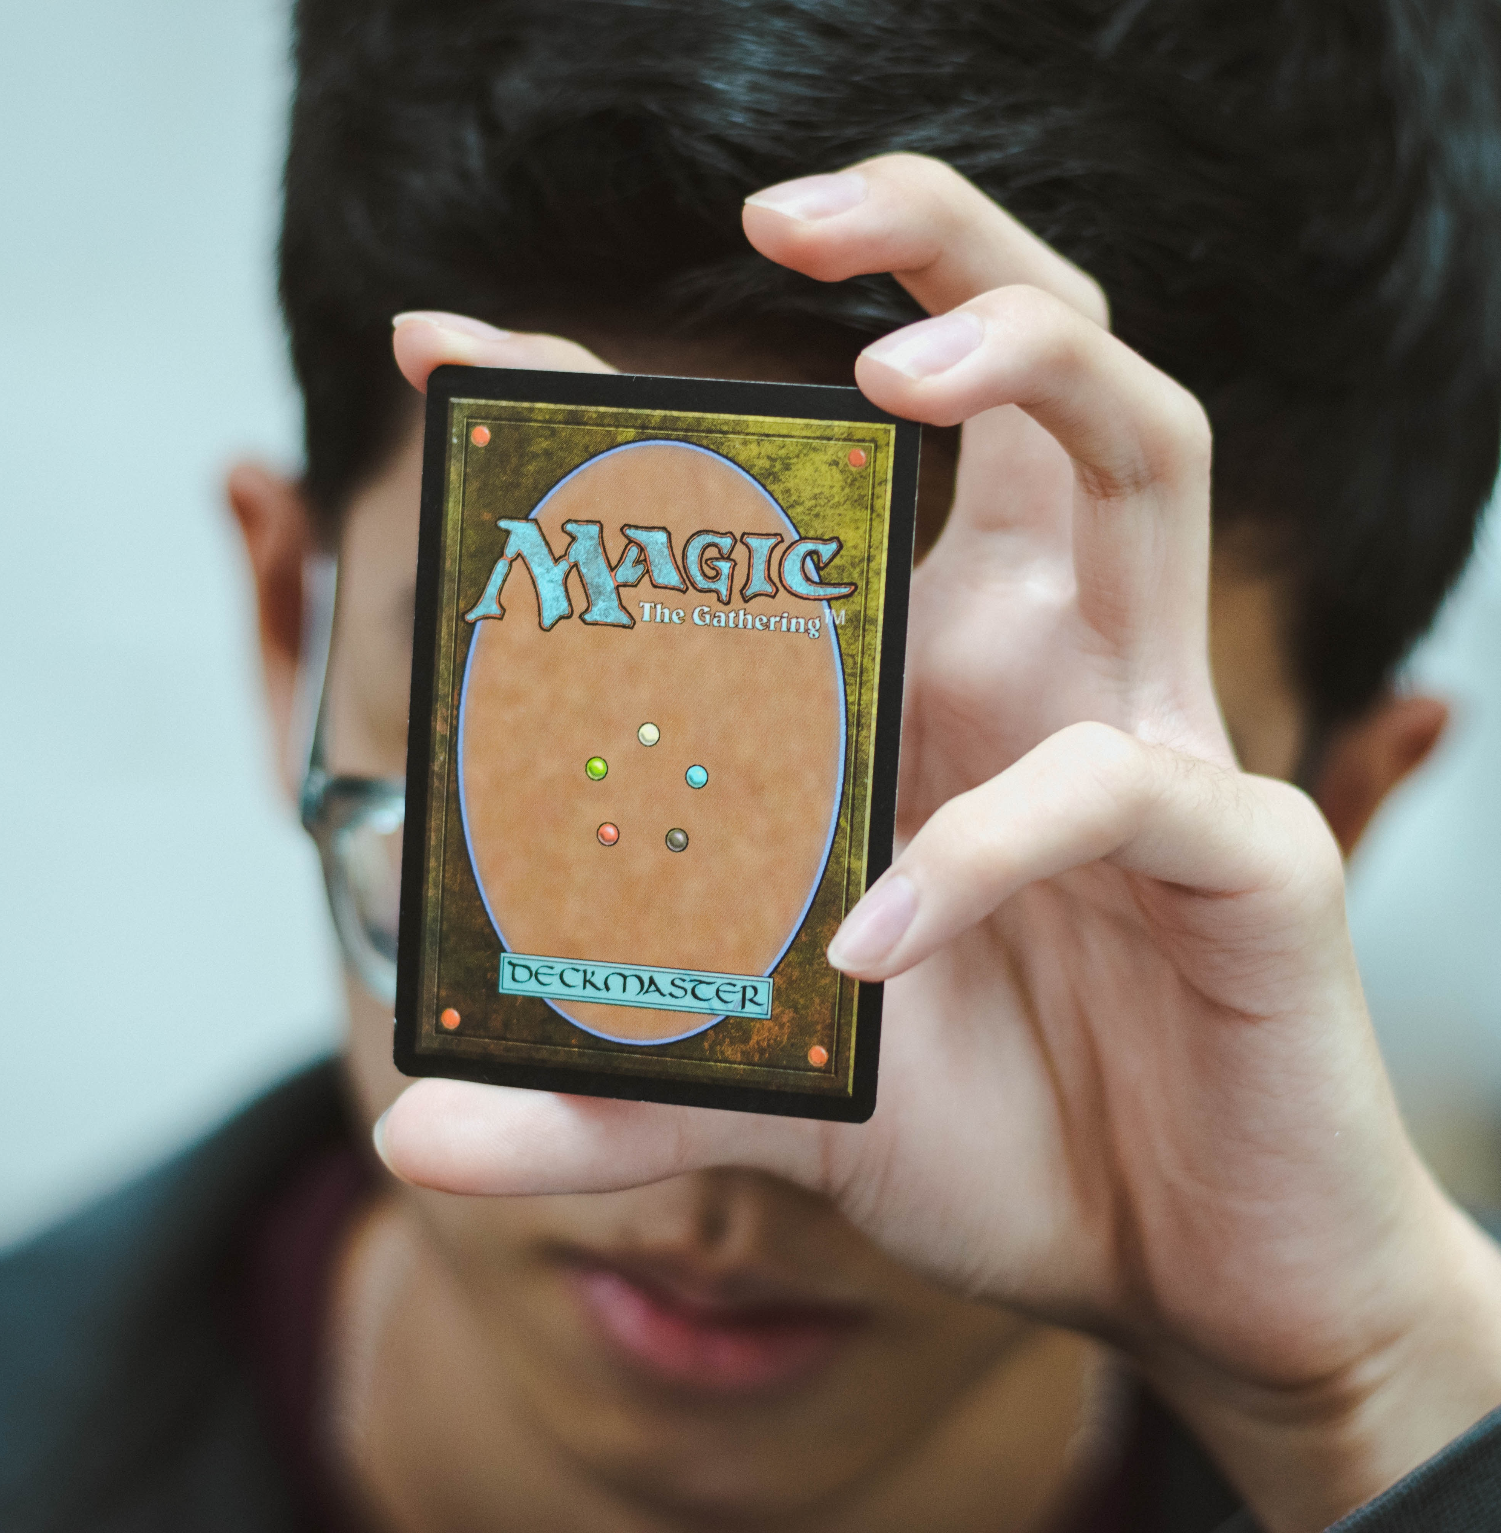
Collectables in prenups: What is the deal?
Has your client made significant investment in a large collection of items?
Does your client have emotional attachments to these items?
Does your client collect items as investments or hobby?
Does your client have a significant quantity of items (card collection) or a few high-end items (watches)?

Slide 4
Common collectibles
Personal Items
Antiques
Comic Books
Trading Cards
Sports Memorabilia

Slide 5
High end assets
Jewelry
Artwork
Handbags
Watches
Cars and Boats

Slide 6
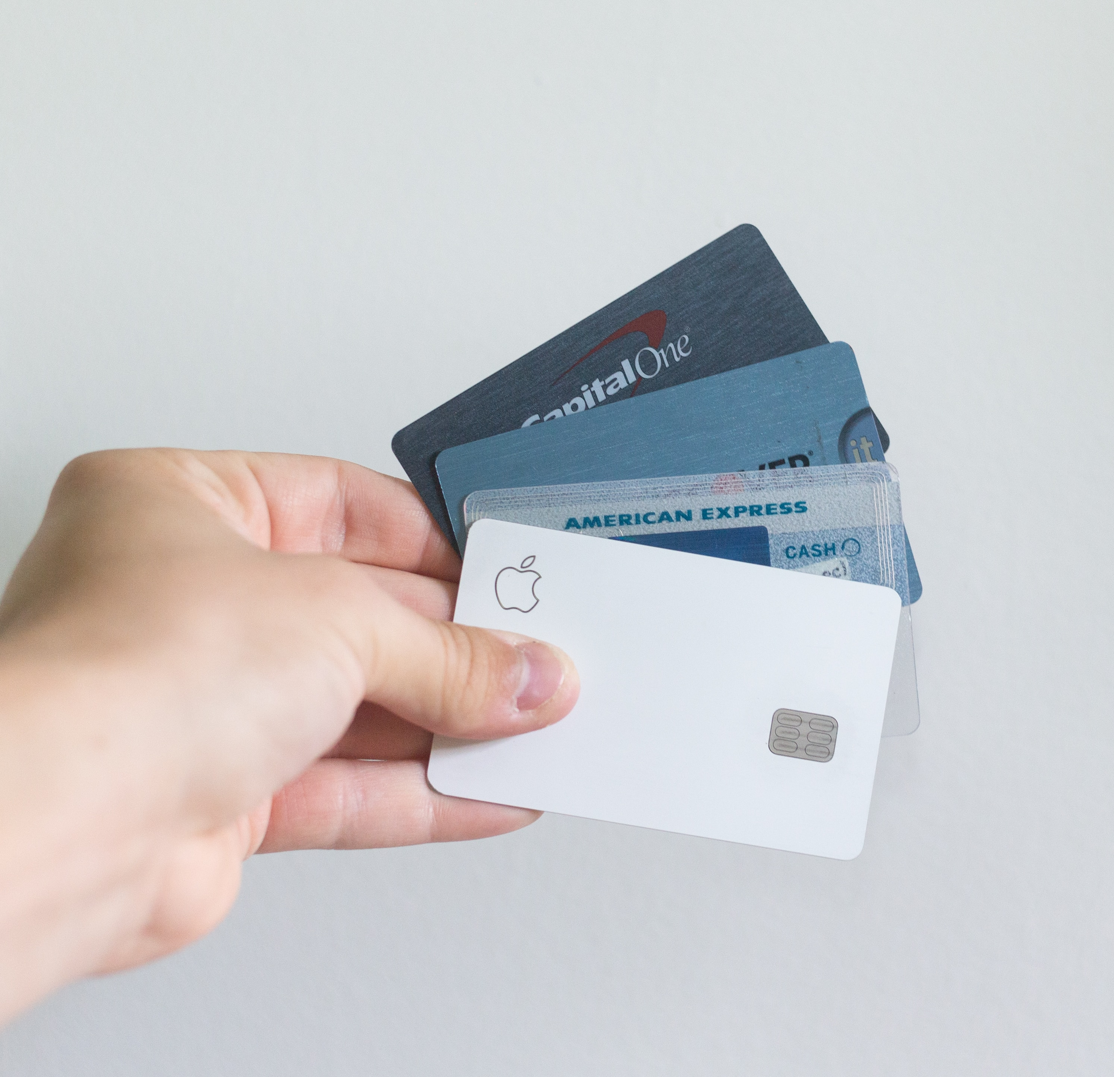
Digital assets
Airline, Hotel and Credit Card Miles/Points
Cryptocurrency
NFT’s
Digital Media Libraries

Slide 7
Intellectual property
Trademarks
Patents
Trade Secrets
Copyright

Slide 8
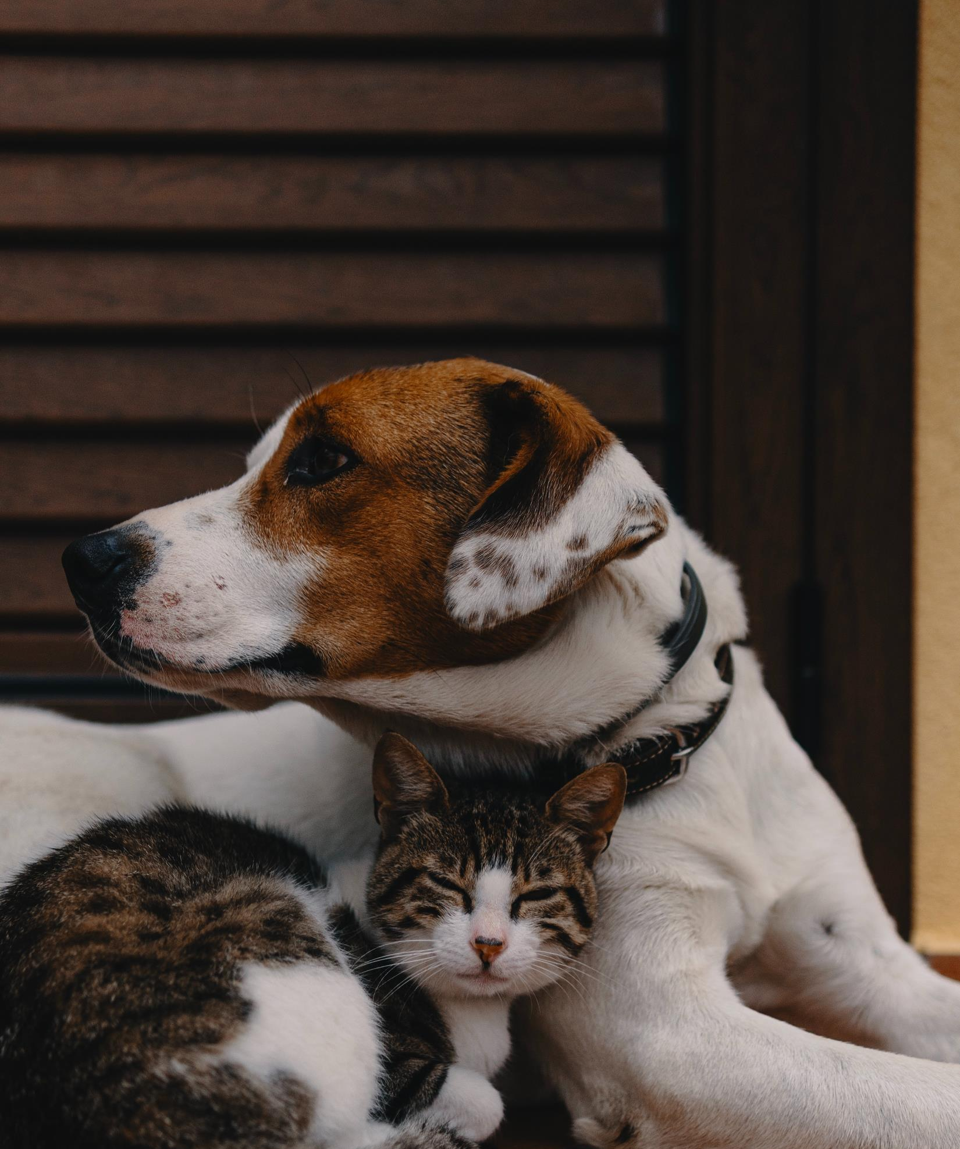
pets

Slide 9
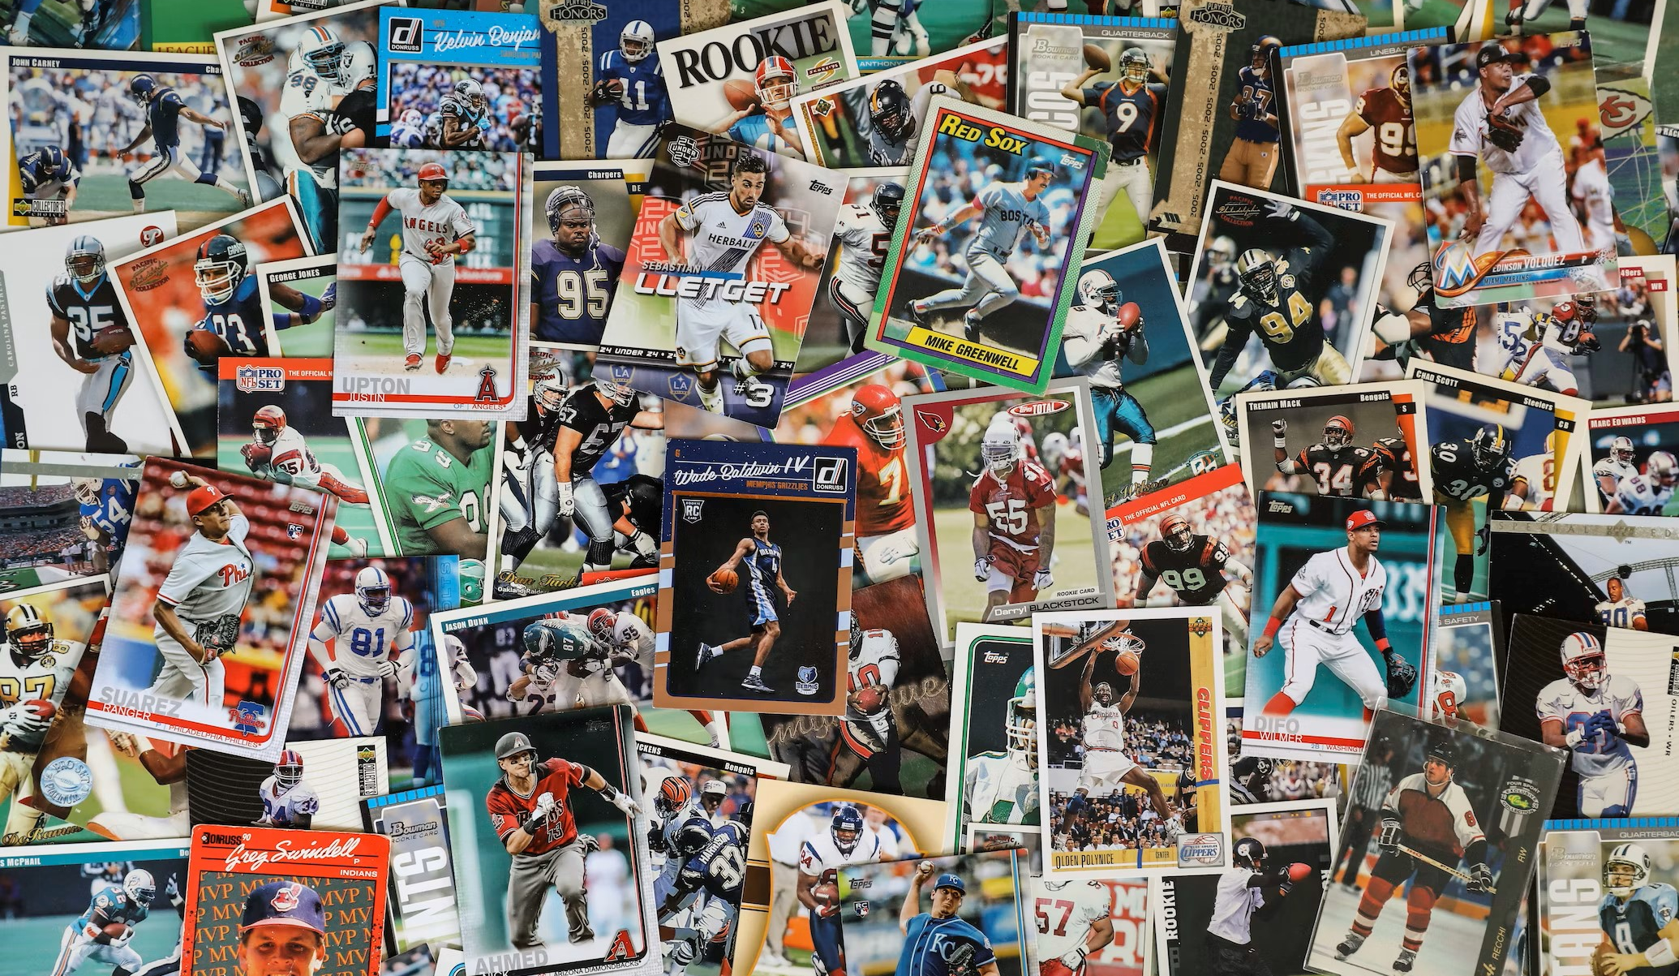
How to Properly Capture unique assets in prenups
1. Cataloguing/ Inventory
2. Valuation
3. Ownership and Division

Slide 10
STEP 1: Cataloguing/ inventory

Slide 11
Cataloging/ inventory: how to take stock
Generally, counsel needs to have their clients physically identify the items in the collection and organize a list for identification.
A way to simplify the process could be to simply identify the party’s collection as a whole and assign a value to the entire collection.

Slide 12
STEP 2: valuation

Slide 13
Valuation: Understanding the values of unique
Certain items can appreciate significantly over time
Making an evaluation of the current and potential future value in good faith or by using experts

Slide 14
STEP 3: Ownership rights and division

Slide 15
Language considerations
Will the agreement only protect the original items of the collection, or will it also include modifications to the collection?
If marital assets are used to purchase additional items for the collection during the marriage, will those items be separate property or marital property?
If a premarital unique asset is sold, are the proceeds from the sale separate or marital property?
These questions need to be addressed in detail in the agreement to avoid any ambiguity should there be a divorce.

Slide 16
Addressing Unique Assets in Death
Language is imperative to include if a party feels strongly about what happens to their separate property after their passing. In the example of collectables or pets, there may be individuals a party wishes to convey such property to other than their spouse.

Slide 17
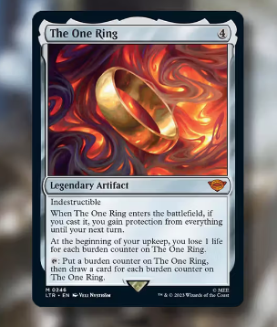
Case study: Magic cards
FACTS: One spouse owned a collection of magic cards. He actively played with them throughout the marriage, and therefore could not distinguish which cards he owned prior to the marriage and which he acquired during the marriage. This collection was worth between 100K – 300K.

Slide 18
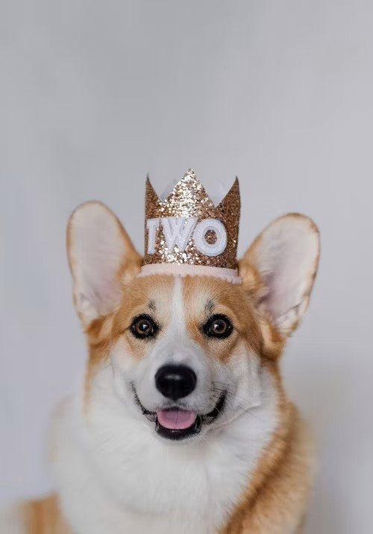
Input from panel
Can you share some of the most unique assets you’ve ever had to deal with in a prenup or a divorce?
The trial of the magic card collection…How would this case have played out differently had there been a prenuptial agreement?
Pet Arbitration-Who keeps who?

Slide 19
THANK YOU

