Slide 1
Welcome to:
MCLE’s Marking Up Title Commitments, Eliminating Exceptions and Getting Endorsements
Jutta R. Deeney, Esq., SVP and New England Regional Underwriting Counsel for Stewart Title Guaranty Company
Tracie Kester, Esq., Massachusetts State Counsel and Assoc. Senior Underwriting Counsel for Stewart Title Guaranty Company
Amanda S. Eckhoff, Esq., Partner at Robinson Cole LLP

Slide 2


Basics of Title Insurance
And
Policy Options

Slide 3
Title Insurance Policies & Types of Policies
What is Title Insurance?
Owner’s Policies / Loan Policies
  Standard a/k/a Basic
  Homeowner’s a/k/a Expanded Policy [1—4 Family Only]
  ALTA (American Land Title Association) Forms

Slide 4
Components of the Title Policy - Jacket
Policy Jacket
  Coverage Statement
  SUBJECT TO THE EXCLUSIONS FROM COVERAGE, THE EXCEPTIONS FROM COVERAGE CONTAINED IN SCHEDULE B, AND THE CONDITIONS, [Blank Title Insurance Company], a [Blank] corporation (the “Company”), insures as of the Date of Policy and, to the extent stated in Covered Risks 9 and 10, after the Date of Policy, against loss or damage, not exceeding the Amount of Insurance, sustained or incurred by the Insured by reason of:
  Covered Risks
  Exclusions from Coverage
  Conditions

Slide 5
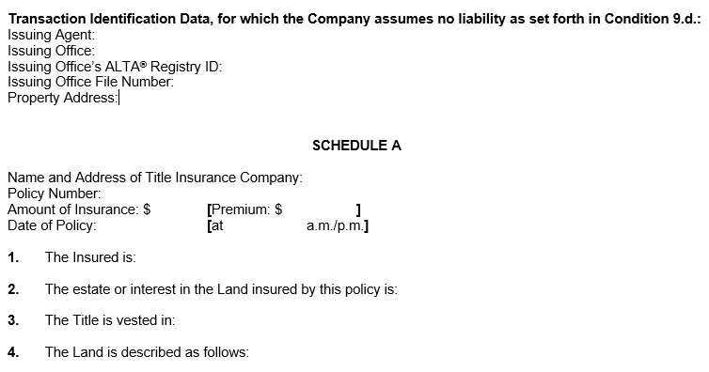
Components of the Policy – Schedule A

Slide 6
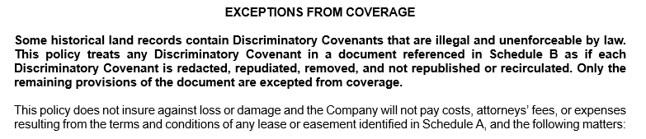
Components of the Policy – Schedule B

Slide 7
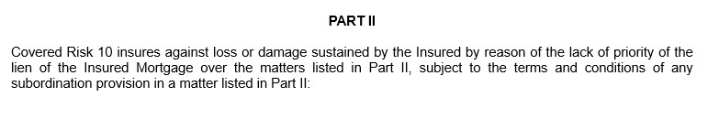
Components of the Policy – Schedule B, Part II
(loan policy only)

Slide 8


Title Search Types
And
Attorney’s Title Review

Slide 9
Title Search
Title Report
  Certification by attorney or examiner as to owner, liens, etc.
  Copies of current deed and encumbrances only
Title Abstract
  Conclusion sheet (similar to what is contained in title report)
  Also includes schedule or “run” sheets and copies of all pertinent documents in the chain

Slide 10
Title Abstract - Conclusion Sheet Sample
PROPERTY: 50 State Street, Springfield, MA OWNER: 50 State Realty, Inc.
Date of Deed: 4/14/2020 Held as: TBE TIC JT I
Date of Recording: 4/15/2020 Recording info: Hampden Book 12345, Page 67 Sheet 40
DESCRIPTION: Lot 2 on Plan Book 47, Page 2 Sheet 2
MORTGAGES / LIENS:
Springfield Bank, 4/15/2020, $1,200,000 Book 12345, Page 70 Sheet 42
Springfield Bank, 1/24/2024, $250,000 Book 24777, Page 21 Sheet 52
EASEMENTS/RESTRICTIONS/TAKINGS:
Easement – WMECO 6/16/1987 Book 8794, Page 1 Sheet 4
REMARKS/OTHER: Review discharge of prior owner mortgage, sheet 17
EXAM BEGIN DATE: 1/1/1972 EXAM END DATE: 3/4/2024

Slide 11
Length of Title Search
MGL c. 93, s. 70 – Certification of Title by Attorney
  Purchase of 1-4 family property to be occupied by buyer
  Purchase money first mortgage – lender’s attorney must certify
  50-year search (unless Registered Land)
Commercial Properties
  Title certification not required by law
  “Starter” title insurance policies frequently used

Slide 12
Title Review
Read through all title documents listed on title search/report and determine applicability and relevance
Determine how title document impacts property
If relevant, discuss document with relevant parties

Slide 13


Preparing
The
Title Commitment

Slide 14
The Title Commitment
What is the Commitment?
The parts of a Commitment
  The Jacket
  The Schedules
    Schedule A
    Schedule BI
    Schedule BII

Slide 15
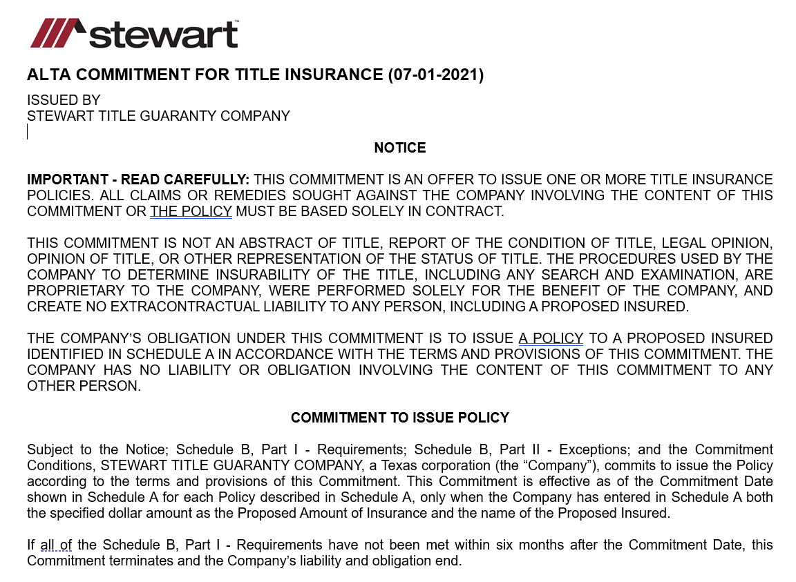





The Title Commitment – The Jacket

Slide 16
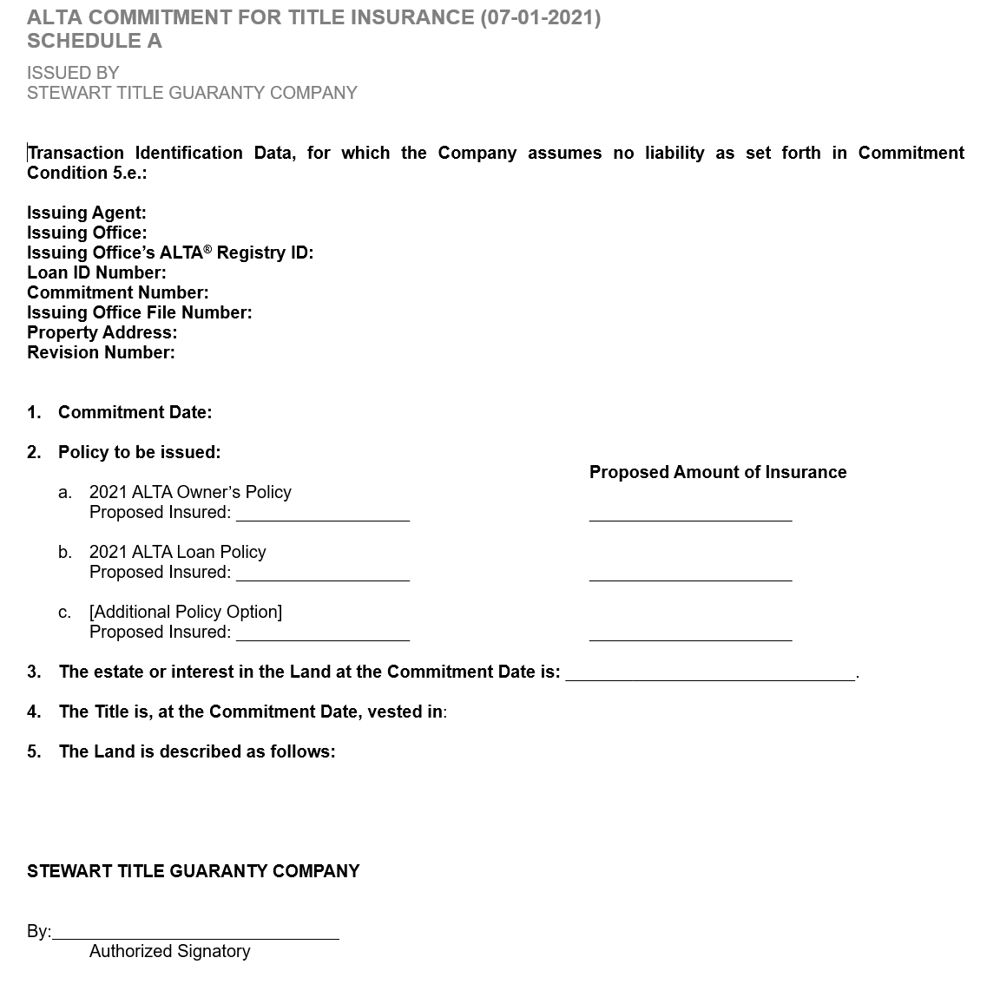
The Title Commitment
Schedule A

Slide 17
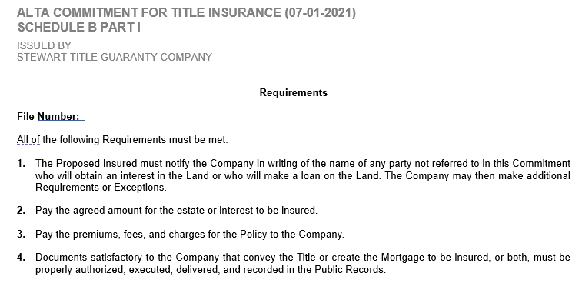
Schedule B Part I

Slide 18
Schedule B part 1 – continued
Sample Requirements
10. Obtain and filed/record a Trustee Certificate Pursuant to M.G.L. Ch. 184 § 35 from Amesbury Realty Trust stating the names of the current trustee/trustees, the Trustee of the Trust has authority to act
11. Obtain and Record Discharge of Mortgage and Security Agreement from 22 Maple Street, LLC, in favor of Capital Funding, LLC, dated March 4, 2014 in the original principal amount of $36,856.627.00 recorded with the Essex County Registry of Deeds at Book 33152, Page 9; as affected by Assignment of Rents and Leases recorded with said Deeds at Book 33152, Page 40
12. Obtain and recorded termination of UCC Financing Statement wherein 22 Maple Street, LLC is Debtor and Capital Funding, LLC is Secured Party recorded with the Essex County Registry of Deeds at Book 33152, Page 67; as affected by UCC Continuation Statement recorded with said Deeds at Book 37335, Page 514
13. Obtain and record a Certificate of Redemption (Release) for Instrument of Taking for taxes by the City of Amesbury in the amount of $5,919.80, dated November 22, 2019 and recorded with the Essex County Registry of Deeds in Book 38142, Page 384

Slide 19
Schedule B, Part 1 – continued
Know your Deal
Schedule B, Part 1 = checklist

Slide 20
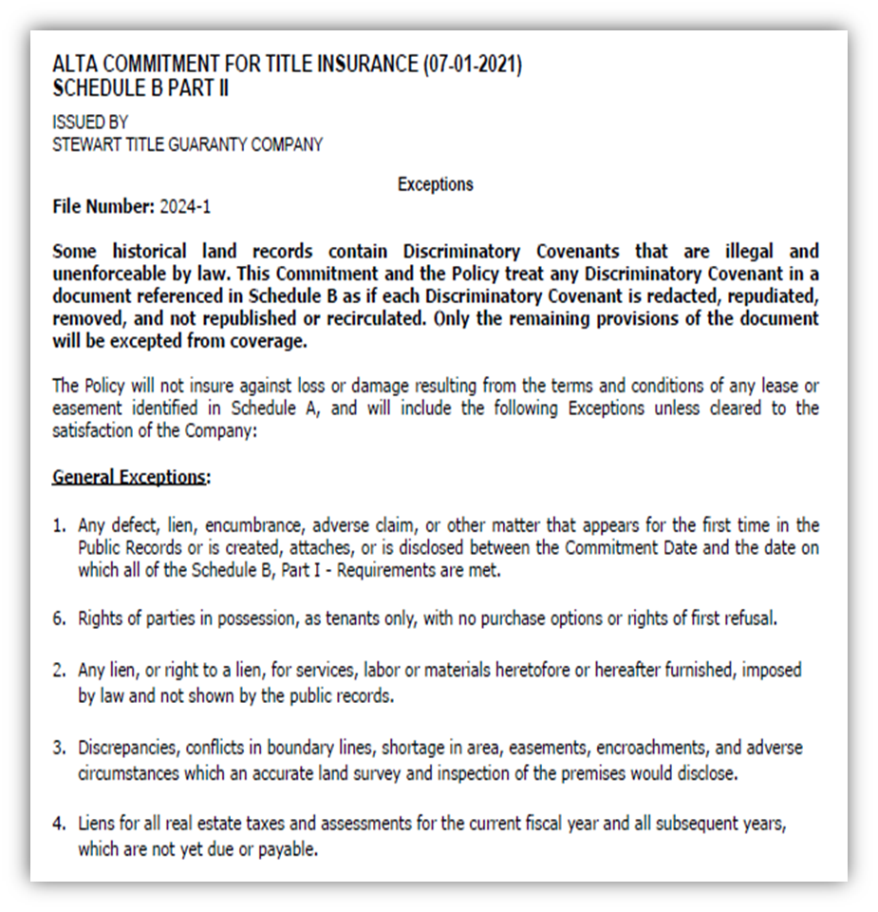
Schedule B Part II

Slide 21
Schedule B Part II – continued
Special Exceptions
6. Terms and conditions of easement rights and right of way to the City of Holyoke for drainage culvert maintenance dated October 16, 1979 and recorded in Book 4859, Page 159.
7. Unrecorded drainage easement to the City of Holyoke as shown on plans recorded in Book of Plans 226, Page 82 and Book of Plans 251, Page 8.
8. Terms and provisions in a Notice of Lease by and between Merchant Devonshire Limited Partnership, as Landlord and Cellco Partnership d/b/a Version Wireless, dated July 15, 2002, recorded with said Deeds, Book 12474, Page 529.
9. Wireless Communication Easement and Assignment Agreement, dated July 6, 2010 by and between Merchant Devonshire Limited Partnership and T6 Unison Site Management LLC, recorded with said Deeds Book 18411, Page 31.
10. Matters shown on a “Plan of Land in Holyoke, Mass. Owned by Andrew J. Lane”, dated August 25, 1987 by R.A. Foresi, Associates, Engineers and Land Surveyors and recorded with the Hampden County Registry of Deeds, in Plan Book 251, Plan 8 including;
A. Unrecorded drainage easement of City of Holyoke.
B. Drainage Easement, including culvert of City of Holyoke at Book 4859, Page 159.
C. Tannery Brook.

Slide 22
Schedule B Part II – continued
Special Exceptions:
What the Title Report May not (Explicitly)Tell You
Land Locked Parcel
  Lack of right of Access
Party Walls (no agreement)
  Rights or interests of the adjoining owners in and relating to a party wall located along or adjacent to the ___ line of the Land.
Land Abutting Navigable Lake
  (a) Rights, if any, of the property owners abutting the __________________, lake or adjoining streams or water in and to the waters of the lake and in and to bed thereof.
  (b) Boating and fishing rights of property owners abutting the lake or the stream of water leading thereto or therefrom.
  (c) Navigational servitudes and all other rights, titles, and powers of the United States, the state, local government and the public over said lake, its bed, and its shore lands extending to the ordinary high water line thereof.
  (d) The consequence of any change in the location of the lake which forms a boundary line of the land, including any determination that some portion of the land has been included within _________________ Lake.
Land Boundary By Ocean/Tidal
  Colonial Ordinance in MA – rights of fishing, fowling, navigation

Slide 23


Commitment Review –
Commercial vs.
Residential Transactions

Slide 24


Common Transactional
Requirements and
Exceptions

Slide 25
Lender Title Policy Requirements
Format of request may vary (list vs. letter)
Main components are similar
Insured party name
Requested insurance amount
List of standard endorsements
List of endorsements requested based on title commitment review

Slide 26
Standard Endorsements
Zoning Endorsement (ALTA 3.1 or 3.2)
Environmental Endorsement (ALTA 8.1 or 8.2)
Comprehensive Endorsement (ALTA 9)
Access (ALTA 17 or 17.1)
Separate Tax Parcel (ALTA 18)
Same As Survey (ALTA 25)
Deletion of arbitration endorsement
Electronic signatures (not applicable in all states)

Slide 27
Other Lender Requirements
Confirm granting entity has property authority
  Certificates and votes from granting entity
  Certificates of Good Standing and Legal Existence
Confirm no statutory priming liens
  Municipal Lien Certificates or other evidence of payment
  6D Certificates (if condominium)
Obtain Surveys and Plot Plans
  Encroachments
  Discrepancies in property descriptions

Slide 28
Other Lender Requirements
Confirm granting entity has property authority
  Certificates and votes from granting entity
  Certificates of Good Standing and Legal Existence
  Required from every level of granting entity

Slide 29
Other Lender Requirements
Confirm no statutory priming liens
  Municipal Lien Certificates or other evidence of payment
  6D Certificates (if condominium)
  Any outstanding amounts must be paid

Slide 30
Other Lender Requirements
Obtain Surveys and Plot Plans
Encroachments
Stuff on the land
Discrepancies in property descriptions
Surveys vs. plot plans
Site complexity
Exception complexity
Available coverage
Cost and timing

Slide 31
FinCEN and Title Insurance
What is FinCEN?
Reporting Obligation
Requirement – Schedule B, Part I
Cash Purchases/Hard Money
Residential property
Certain MA Counties
Non-natural/legal entity
$300K or more

Slide 32
Schedule B part 1 – continued
FinCEN Requirement
This Company is required by Federal Law to collect certain additional information from you and the parties representing you regarding the purchase of real property. US Code Title 31-Sec 5326 authorizes the U.S Department of Treasury to collect information about the certain transaction as specified in various geographic targeting orders for the purpose of preventing evasion of the Bank Secrecy Act. As a result of a Geographic Targeting Order ("GTO") issued by the United States Department of Treasury, Financial Crimes Enforcement Network ("FinCEN"), this transaction may be responsive to the requirements of the GTO. You may be required, as a condition of the issuance of the policy to provide additional information that will be reported to FinCEN. Please contact this company and provide the details of this transaction in order to comply with the GTO.
If the transaction meets the reporting requirement, you will be asked to provide information on the identity of the parties to the transaction, which will be reported to FinCEN. This company is prohibited from issuing its policy if the transaction is reportable and the information is not provided for reporting. Additional exceptions and/or requirements may be raised.

Slide 33
Satisfying Requirements
And
Removing Exceptions

Slide 34
Requirements – Title Commitment Schedule B
Integrate with Closing Agenda
Identify who is responsible for agenda item
Include column for status
At closing vs. pre-closing
Drafts for review
Waiver of requirements

Slide 35
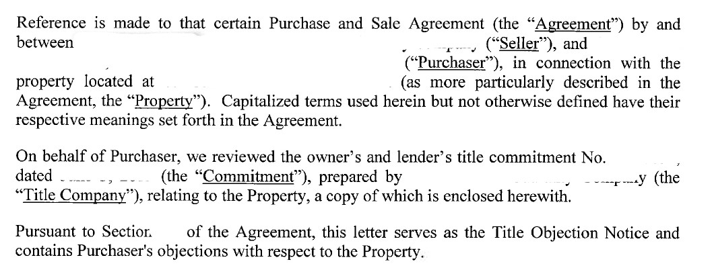
Title objection letter sample

Slide 36
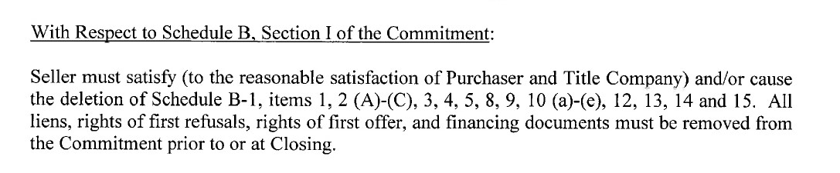
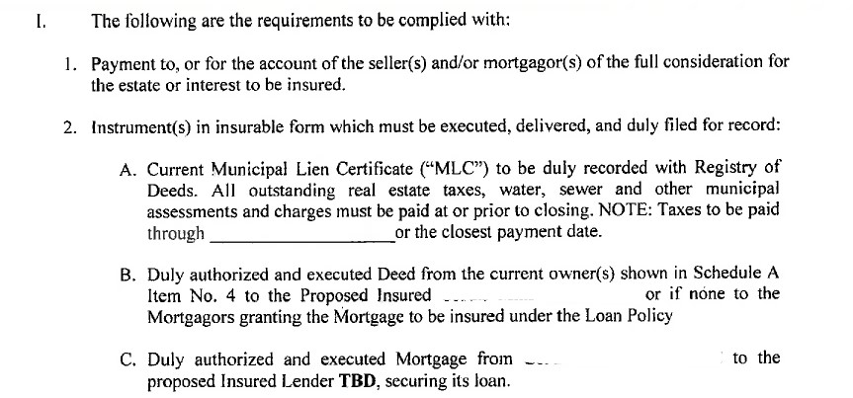
Title objection letter - requirements

Slide 37
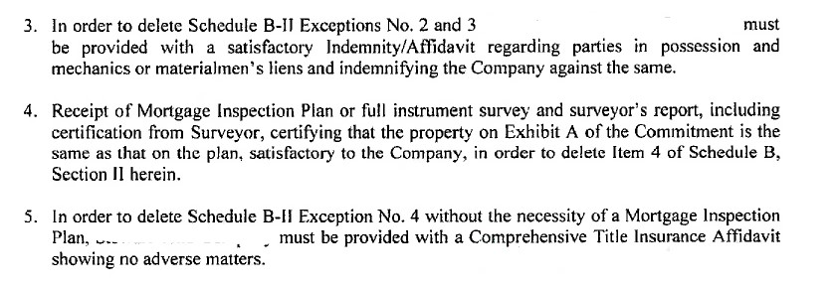
Title objection letter – requirements, cont.

Slide 38
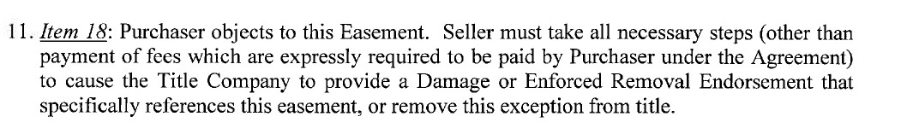
Title objection letter – Exceptions (Easement)

Slide 39
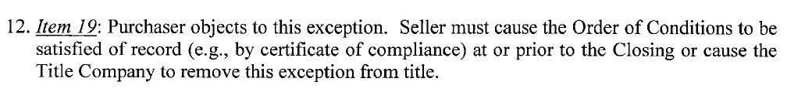

Title objection letter – Exceptions (OOC)

Slide 40
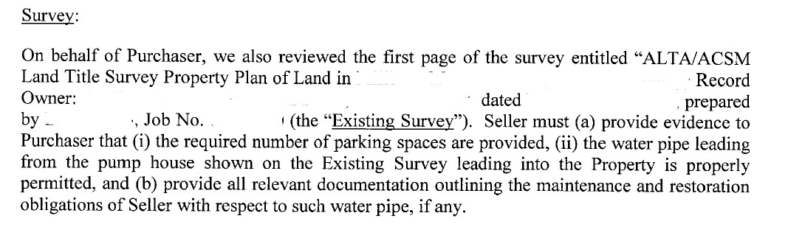
Title Objection Letter - Survey

Slide 41

The Pro Forma Title Policy
In a
Commercial Transaction

Slide 42
Pro Forma Policy
This is a Pro Forma Policy, which provides no insurance coverage, furnished to or on behalf of the proposed insured. This pro forma does not reflect the present status or condition of title and is not a commitment to insure the estate or interest or to provide any affirmative coverage shown herein. Any commitment must be an expressly written undertaking issued on the appropriate forms of the Company. This Pro Forma Policy solely indicates the form and content of the Policy which the Company may issue if all necessary documents are furnished, all acts are performed, and all requirements set forth in the title commitment covering this property (or that may be required by underwriting) are met to the satisfaction of the Company.

Slide 43
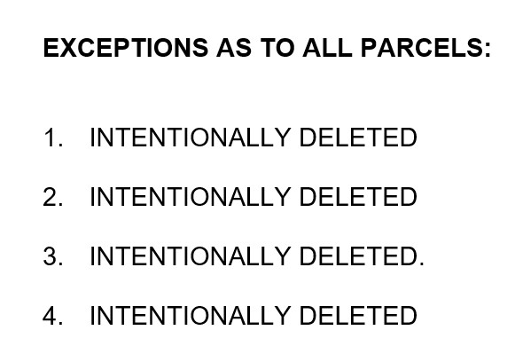
Pro Forma Policy – Schedule B

Slide 44


Common
Endorsements

Slide 45
Endorsements
Add additional coverages (e.g., Zoning)
Make changes to the jacket (e.g., Delete Arbitration)
Most endorsement forms promulgated by ALTA
  CLTA (California Land Title Association)
  Proprietary (company specific)

Slide 46
The ALTA 9 Endorsements: REM
(Restrictions, Encroachments, and Minerals)
ALTA 9-06:
Restrictions, Encroachments, and Minerals – Loan Policy
ALTA 9.7-06:
Restrictions, Encroachments, and Minerals – Land Under Development - Loan Policy
ALTA 9.10-06:
Restrictions, Encroachments, and Minerals – Current Violations – Loan Policy
Covenant violations
Recorded notices of violation of environmental protection covenant
Enforced removal of encroachment into building setback on recorded plan
Encroachment of improvement
Damage to improvement (easement or mineral rights)

Slide 47
The ALTA 9 Endorsements: CCR
(Covenants, Conditions, and Restrictions)
ALTA 9.3-06:
Covenants, Conditions, and Restrictions – Loan Policy
ALTA 9.1-06:
Covenants, Conditions, Restrictions – Unimproved Land – Owner’s Policy
ALTA 9.2-06:
Covenants, Conditions, Restrictions – Improved Land – Owner’s Policy
ALTA 9.8-06:
Covenants, Conditions, Restrictions – Land Under Development – Owner’s Policy
NO coverage for encroachments
Covenant violations are covered

Slide 48
The ALTA 9 Endorsements: Private Rights
ALTA 9.6-06:
Private Rights – Loan Policy
ALTA 9.6.1-06:
Private Rights – Current Assessments – Loan Policy
ALTA 9.9-06:
Private Rights – Owner’s Policy
Definition of “Covenants” in the Private Rights endorsements are limited to recorded documents – different in the REM/CCR

Slide 49
ALTA 17 – Access Endorsements
ALTA 17-06:
Access and Entry
ALTA 17.1-06:
Indirect Access and Entry
ALTA 17.2-06:
Utility Access
Can be issued with both loan and owner policies

Slide 50
Location & Same as Survey Endorsements
ALTA 22-06:
Location
ALTA 25-06:
Same as Survey
Can be issued with both loan and owner policies

Slide 51
ALTA 28 – Easements and Encroachments
ALTA 28-06:
Easement – Damage or Enforced Removal
ALTA 28.1
(or 28.1-06):
Encroachments – Boundaries and Easements
ALTA 28.2-06:
Encroachments – Boundaries and Easements – Described Improvements
ALTA 28.3-06:
Encroachments – Boundaries and Easements –
Land Under Development
(Building only)
Can be issued with both loan and owner’s policies

Slide 52
Loan Related Endorsements
ALTA 6 & 6.2:
(or 6-06 & 6.2-06)
Variable Rate & Negative Amortization
ALTA 27
(or 27-06):
Usury
ALTA 14
(4 kinds)
(or -06 versions):
Future Advances
ALTA 32
(3 kinds)
(or -06 versions):
Construction Loan
ALTA 29-06
(4 kinds)
Interest Rate Swap Endorsements
ALTA 33-06:
Disbursement

Slide 53
ALTA 3 – Zoning
ALTA 3:
Zoning
ALTA 3.1
Zoning- Completed Structure
ALTA 3.2:
Zoning – Land Under Development
ALTA 3.3
Zoning – Completed Improvement – Non-Conforming Use
ALTA 3.4
Zoning – No Zoning Classification
Can be issued with both loan and owner’s policies
There are also -06 versions for use with prior policies

Slide 54
Specialty Endorsements
Know your deal
Know what endorsements are available
Examples:
  Leasehold
  Energy Transactions
  https://www.alta.org/policies-and-standards/policy-forms/

Slide 55


Issuing The
Final Policy

Slide 56
Policy Issuance – Residential Transactions
Involved Parties
  Closing Attorney
    Lender Counsel
    Title Attorney/Agent
    Buyer Counsel (limited representation)
  Buyer Counsel
  Seller Attorney

Slide 57
Policy Issuance – Residential Transactions
Getting to Record:
  Title Rundown
    Date of Commitment – Closing date
  Recording
  Disbursing
Policy Preparation

Slide 58
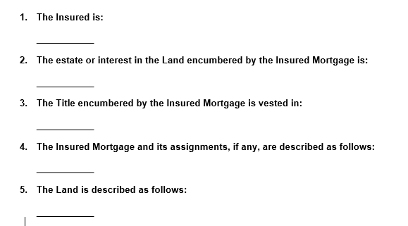
The Policy – Schedule A

Slide 59
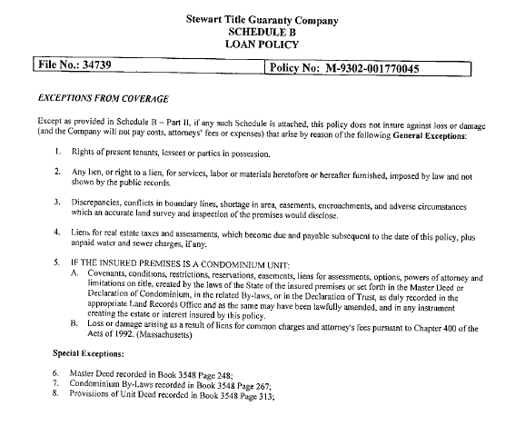
The Policy –
Schedule B a/k/a B-1
(Commitment Schedule B-II)

Slide 60
Policy Issuance – Commercial Transactions
Involved Parties
  Title Attorney Agent
  Escrow Agent/Settlement Agent
  Buyer Counsel
  Seller Counsel
  Lender Counsel
Pro Forma
Closing Instruction Letter

Slide 61

Thank you

